Slide 1
CH-7

Slide 2
Introduction to NoSQL
NoSQL (Not Only SQL) databases are designed to handle large volumes of unstructured and semi-structured data. Unlike traditional relational databases that rely on fixed schemas and tables, NoSQL offers flexible data models and supports horizontal scaling. This makes them well-suited for modern applications that require high performance, scalability, and the ability to manage diverse data types efficiently.

Slide 3
Key Features of NoSQL Databases
Dynamic schema: Allow flexible shaping of data to meet new requirements without the need to migrate or change schemas.
Horizontal scalability: They scale horizontally for adding more nodes into the existing ones and acquire enough storage for even bigger datasets and much higher traffic by distributing the load on multiple servers.
Document-based: Data are presented in flexible, semi-structured formats like JSON/BSON (e.g., MongoDB).
Key-value-based: They possess a simple but fast access pattern (e.g., Redis) by storing data as pairs of keys and values.
Column-based: Data are organized into columns instead of rows (e.g., CASSANDRA).
Distributed and high availability: They are designed to be highly available and to automatically handle node failures and data replication across multiple nodes in a database cluster.
Flexibility: Allow developers to store and retrieve data in a flexible and dynamic manner, with support for multiple data types and changing data structures.
Performance: Perfect for big data and real-time analytics and high volume applications.

Slide 4
Types of NoSQL Databases
Databases store organized data for easy access and management. Traditional relational databases use structured tables, but modern applications and big data have driven the rise of NoSQL systems. NoSQL databases handle large volumes of unstructured and semi-structured data, offering the scalability and flexibility today’s diverse workloads demand.
Types of NoSQL Database
NoSQL databases can be classified into four main types, based on their data storage and retrieval methods:
Document-based databases
Key-value stores
Column-oriented databases
Graph-based databases
Each type has unique advantages and use cases, making NoSQL a preferred choice for big data applications, real-time analytics, cloud computing and distributed systems.

Slide 5
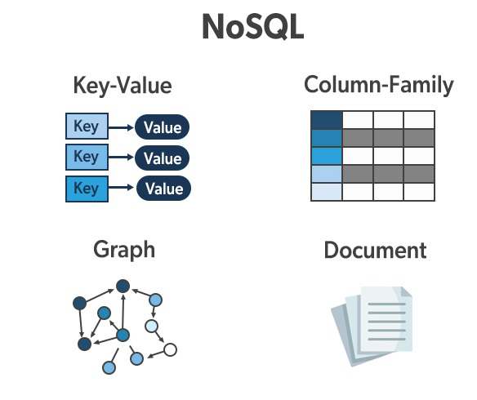

Slide 6
1. Document-Based Database
The document-based database is a nonrelational database. Instead of storing the data in rows and columns (tables), it uses the documents to store the data in the database. A document database stores data in JSON, BSON or XML documents.
Documents can be stored and retrieved in a form that is much closer to the data objects used in applications which means less translation is required to use these data in the applications. In the Document database, the particular elements can be accessed by using the index value that is assigned for faster querying.
Collections are the group of documents that store documents that have similar contents. Not all the documents are in any collection as they require a similar schema because document databases have a flexible schema.
Key features of document database:
Flexible schema: Documents in the database has a flexible schema. It means the documents in the database need not be the same schema.
Faster creation and maintenance: the creation of documents is easy and minimal maintenance is required once we create the document.
No foreign keys: There is no dynamic relationship between two documents so documents can be independent of one another. So, there is no requirement for a foreign key in a document database.
Open formats: To build a document we use XML, JSON, and others.

Slide 7
A Document Data Model is a lot different than other data models because it stores data in JSON, BSON, or XML documents. in this data model, we can move documents under one document and apart from this, any particular elements can be indexed to run queries faster. Often documents are stored and retrieved in such a way that it becomes close to the data objects which are used in many applications which means very less translations are required to use data in applications. JSON is a native language that is often used to store and query data too.
So in the document data model, each document has a key-value pair below is an example for the same.
{
"Name" : "Yashodhra",
"Address" : "Near Patel Nagar",
"Email" : "yahoo123@yahoo.com",
"Contact" : "12345"
}

Slide 8
2. Key-Value Stores
A key-value store is a nonrelational database. The simplest form of a NoSQL database is a key-value store. Every data element in the database is stored in key-value pairs. The data can be retrieved by using a unique key allotted to each element in the database. The values can be simple data types like strings, numbers or complex objects. A key-value store is like a relational database with only two columns which is the key and the value.
Key features of the key-value store:
Simplicity: Data retrieval is extremely fast due to direct key access.
Scalability: Designed for horizontal scaling and distributed storage.
Speed: Ideal for caching and real-time applications.

Slide 9
Key | Value
user101 | {"name":"Anita","city":"Delhi"}
cart42 | {"items":["book","pen"],"total":450}

Slide 10
3. Column Oriented Databases
Columnar databases are those where the data is stored in columns instead of rows as is done in the traditional row-based databases as they offer impressive benefits in certain types of queries and data manipulation operations. Therefore, databases that are organized in columns provide better performances for operations that require applications to read data such as data analytics and data warehousing. This approach enhances the rate of query processing and reduces disk I/O making it suitable for cases that involve a large number of queries that are processed on large amounts of data.
Columnar Database VS Row Database
Both Columnar and Row databases are a few methods used for processing big data analytics and data warehousing. But their approach is different from each other.
For example:
Row Database: "Customer 1: Name, Address, Location."(The fields for each new record are stored in a long row).
Columnar Database: "Customer 1: Name, Address, Location."(Each field has its own set of columns).

Slide 11
4. Graph-Based Databases
Graph-based databases focus on the relationship between the elements. It stores the data in the form of nodes in the database. The connections between the nodes are called links or relationships, making them ideal for complex relationship-based queries.
Data is represented as nodes (objects) and edges (connections).
Fast graph traversal algorithms help retrieve relationships quickly.
Used in scenarios where relationships are as important as the data itself.
Key features of Graph Database
Relationship-Centric Storage: Perfect for social networks, fraud detection, recommendation engines.
Real-Time Query Processing: Queries return results almost instantly.
Schema Flexibility: Easily adapts to evolving relationship structures

Slide 12
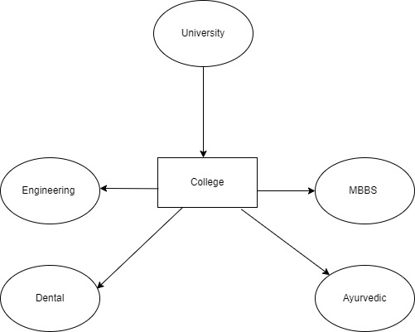

Slide 13
How NoSQl Database Works
Let’s understand this through a step-by-step working concept
1. Data Storage Model
Unlike relational databases, which use tables, NoSQL uses different data storage models:
Type | Example | Data Model | Description
Key–Value Store | Redis, DynamoDB | { key: value } | Data stored as key-value pairs, like a dictionary.
Document Store | MongoDB, CouchDB | { "name": "John", "age": 25 } | Stores JSON-like documents with flexible structure.
Column Store | Cassandra, HBase | Columns grouped into families | Optimized for fast retrieval of columns rather than rows.
Graph Store | Neo4j | Nodes and edges | Used to represent relationships (e.g., social networks).

Slide 14
2. Schema Flexibility
You don’t have to predefine a schema.
Each record (like a document) can have different fields.
This allows easy updates and addition of new data fields.
Example (Document-based):
{
"name": "John",
"age": 25,
"skills": ["HTML", "CSS", "JS"]
}
and another document in the same collection could be:
{
"name": "Sara",
"department": "Sales",
"experience": 3
}

Slide 15
3. Data Access
NoSQL databases use their own query methods or APIs.
Example (MongoDB):
db.students.find({ age: { $gt: 20 } })
4. Replication and Sharding (Scalability)
This is one of the core strengths of NoSQL:
Replication: Copies of data are stored on multiple servers for reliability.
Sharding: Data is split across multiple machines to handle large-scale workloads.
Think of it like — instead of one giant machine handling everything, many smaller ones share the load.

Slide 16
5. Consistency Model
NoSQL databases often follow the BASE model (instead of ACID):
This means:
They focus more on availability and speed,
while allowing eventual consistency (data syncs across servers over time).
Relational (SQL) | NoSQL (BASE)
Atomic | Basically Available
Consistent | Soft state
Isolated | Eventually consistent
Durable

Slide 17
6. Data Retrieval and Indexing
NoSQL uses indexes for fast lookups (similar to SQL but more flexible).
Indexes can be on any field — even nested fields (in document databases).
7. Performance Optimization
Because data is often stored close to how it’s used by the application, you avoid complex joins — this makes it much faster for many use cases like:
Real-time analytics
E-commerce recommendation systems
Social media feeds

Slide 18
Introduction to MongoDB
MongoDB is a NoSQL (non-relational), document-oriented database. It stores data in a flexible JSON-like format instead of tables and rows like SQL databases.
👉 In short:
MongoDB = “Database that stores data as documents (like JSON), not as tables.”
Key Idea
In a relational database (SQL), data is stored like this:
ID | Name | Age | City
1 | Riya | 22 | Mumbai

Slide 19
But in MongoDB, the same record is stored as a document:
{
"_id": 1,
"name": "Riya",
"age": 22,
"city": "Mumbai"
}
So MongoDB works with collections of documents rather than tables of rows.

Slide 20
MongoDB Structure (Basic Terms)
SQL Term | MongoDB Equivalent | Meaning
Database | Database | Container for collections
Table | Collection | Group of related documents
Row | Document | A single record (JSON object)
Column | Field | Key-value pair inside a document
Primary Key | _id | Unique identifier for each document

Slide 21
How MongoDB Works
Data stored as documents in a collection.
Each document is a JSON (internally stored as BSON – Binary JSON).
You can insert, read, update, or delete documents using simple commands.
No fixed schema – every document can have different fields.
It supports indexing, aggregation, replication, and sharding for performance and scalability.

Slide 22
Example:
Insert Document:
db.students.insertOne({
name: "Amit",
age: 23,
course: "MCA",
marks: 85
})
db.students.insertOne({
name: "Priya",
course: "MSc IT",
hobbies: ["reading", "coding"]
})

Slide 23
Retrieve documents:
db.students.find()
Output:
[
{ "name": "Amit", "age": 23, "course": "MCA", "marks": 85 },
{ "name": "Priya", "course": "MSc IT", "hobbies": ["reading", "coding"] }
]
Query example:
db.students.find({ course: "MCA" })

Slide 24
Main Features of MongoDB:
Schema-less: Flexible structure (no need to predefine columns).
Document-oriented: Stores data in JSON-like documents.
Scalable: Supports horizontal scaling (sharding).
High performance: Uses indexing and in-memory storage.
Replication: Data copied across servers for reliability.
Aggregation framework: For analyzing and summarizing data (like SQL GROUP BY).
Supports rich queries: Filters, ranges, sorting, projections.

Slide 25
Where MongoDB Is Used
E-commerce platforms (product catalogs, reviews)
Social networking apps (user profiles, posts)
Content management systems (blogs, articles)
Real-time analytics dashboards
IoT and mobile apps (fast data storage)

Slide 26
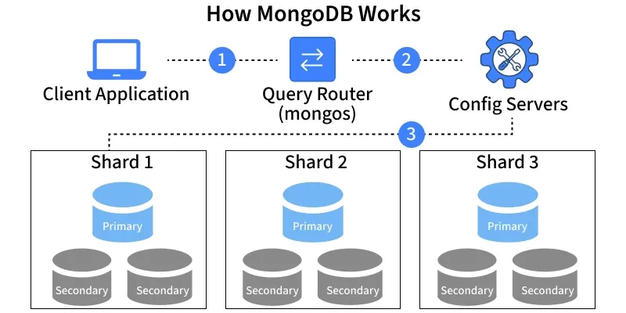

Slide 27
Client Application: The application sends requests to MongoDB to read or write data.
Query Router (mongos): The query router receives the client request and determines which shard should handle it.
Config Servers: Store metadata about the cluster, including which data resides on which shard.
Shards: Data is horizontally distributed across replica sets, with the primary handling writes and secondaries providing replication and reads.
Primary Node: Handles all write operations.
Secondary Nodes: Replicate data from the primary for high availability and read operations.

Slide 28
SQL vs NoSQL
Feature | SQL (Relational Database) | NoSQL (Non-Relational Database)
Full Form | Structured Query Language | Not Only SQL
Data Model | Table-based (Rows & Columns) | Document, Key-Value, Column, or Graph
Schema | Fixed Schema (structure predefined) | Dynamic / Flexible Schema
Scalability | Vertically Scalable (add more CPU/RAM) | Horizontally Scalable (add more servers)
Examples | MySQL, PostgreSQL, Oracle, SQL Server | MongoDB, Cassandra, Redis, CouchDB
Query Language | Uses SQL commands (SELECT, JOIN, etc.) | Uses various APIs / Query languages
Best For | Complex queries, ACID transactions | Large, unstructured or semi-structured data
Consistency | Strong consistency (ACID) | Eventual consistency (BASE)

Slide 29
Use of JSON with Document Database
JSON (JavaScript Object Notation) is the standard format for storing and exchanging data.
Document databases like MongoDB store documents as JSON or BSON.
JSON allows nesting of data, making it ideal for storing real-world entities (like users, orders, products).
{
"product_id": 123,
"name": "Bluetooth Headphones",
"price": 2499,
"features": ["Wireless", "Noise Cancellation", "Mic"],
"reviews": [
{ "user": "Raj", "rating": 5 },
{ "user": "Simran", "rating": 4 }
]
}

Slide 30
Example: Product Data in an E-commerce Website
{
"product_id": 2025,
"name": "Bluetooth Headphones",
"brand": "Boat",
"price": 1999,
"stock": 150,
"reviews": [
{ "user": "Neha", "rating": 5, "comment": "Excellent sound quality!" },
{ "user": "Amit", "rating": 4, "comment": "Good battery life." }
],
"specifications": {
"color": "Black",
"connectivity": "Bluetooth 5.0",
"warranty": "1 year"
}
}

Slide 31
Querying JSON Documents (Example in MongoDB):
// Find all products by brand 'Boat'
db.products.find({ "brand": "Boat" });
// Find product with rating >= 4
db.products.find({ "reviews.rating": { $gte: 4 } });

Slide 32
JSON in Relational Databases
Traditional SQL databases (like MySQL, PostgreSQL, SQL Server) now also support JSON to handle semi-structured data.
This allows combining the power of SQL queries with the flexibility of JSON.
Example (MySQL / PostgreSQL):
CREATE TABLE products (
id INT,
name VARCHAR(100),
details JSON
);
INSERT INTO products VALUES
(1, 'Laptop', '{"brand": "HP", "RAM": "16GB", "SSD": "512GB"}');
SELECT
name,
details->>'brand' AS brand_name
FROM products;

Slide 33
Advantages:
Store both structured and semi-structured data
Query inside JSON objects using SQL functions
Easier migration between SQL and NoSQL models

